Slide 1
Artificial Intelligence (Machine Learning & Deep Learning)
{
Data Types & Measures of Central Tendency
}
...

Slide 2
{
..
"We don't have better algorithms. We just have more data." – Peter Norvig (Director of Research at Google)
}
..

Slide 3
Contents of Day 8
Data Types & Measures of Central Tendency
Recap & introduction | Moving from Python OOP to Data Science. Why AI needs data.
Core Thoery | Big Data | Data and its types (Structured, Unstructured) Data Types | Quantitative (Numerical, Continuous, Discrete) Qualitative (Categorical, Nominal, Ordinal, Binary). The Math | Measures of Central Tendency (Mean, Median, Mode).
Lab Practice | Practical coding tasks implementing method
Advance Lab | Practice advance coding examples to understand the how it works
Wrap-up & Q&A | Debugging tips along with Q&A and suggestion
Important: Use of AI for solving given task is not allowed. Cellphones must be put on silent.

Slide 4
Today Objective - Flexibility & Strict Rules
You can write the most beautiful, complex Object-Oriented Neural Network in the world. But if you don't feed it thousands of examples (Data), it is just a useless, empty calculator. You cannot teach an AI what a "good" property investment is without showing it 10,000 real-world property prices first.
Artificial Intelligence is not magic. It is pattern recognition built on data.
Machine Learning Learns patterns from structured datasets.
Examples: prediction, classification, regression.
Deep Learning uses neural networks.
Designed to process high-dimensional, unstructured data.
Key Principle:
The quality and type of data determines the quality of intelligence.
Garbage data → Garbage model
}
..

Slide 5
Core Concept (Definition & Rules)
Structured vs. Unstructured Data
Definition:
Unstructured Data: Data without a predefined format or schema.
Examples:
Text
Images
Audio
Video
Social media posts
AI Perspective: Unstructured data must be transformed into structured representations:
Text → Tokens → Vectors
Images → Pixel matrices → Tensors
Audio → Spectrogram features
Structured Data: Data organized into predefined schemas such as rows and columns, they have like Tabular format, Fixed schema, Easily searchable, Stored in relational databases
Examples:
Student records
Sales transactions
Bank statements
AI Perspective: Traditional ML algorithms operate efficiently on structured numeric features.

Slide 6
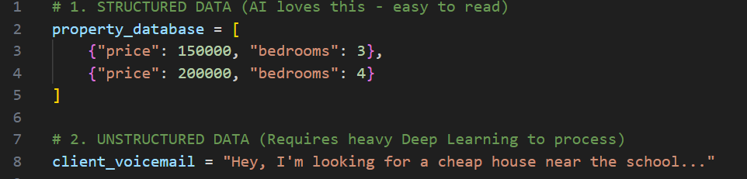
Core Concept (Definition & Rules)
Structured vs. Unstructured Data

Slide 7
Core Concept (Definition & Rules)
Quantitative Data (Numerical Variables)
Definition:
Data expressing a certain quantity, amount, or range. It deals with numbers and things you can measure objectively.
Discrete Variables: Numbers that can only take specific, separate values (usually counted whole numbers), Number of failed login attempts = 4
Continuous Variables: Numbers that can take any value within a range (usually measured and includes fractions/decimals), Model prediction confidence = 0.8732

Slide 8
Core Concept (Definition & Rules)
Qualitative Data (Categorical)
Definition:
Data that can be arranged into categories based on traits, labels, or anything that does not have a strict mathematical value.
Nominal: Categories with NO logical order or ranking.
Ordinal: Categories with a clear, logical ranking/order.
Binary: Only two possible, mutually exclusive outcomes.
Nominal: The house is painted Blue. Blue isn't mathematically better than Red; it's just a label.
Ordinal: The house condition is: Poor, Good, or Excellent. (There is a clear upgrade path).
Binary: Does it have a swimming pool? Yes or No

Slide 9
Core Concept (Definition & Rules)
Measures of Central Tendency
Definition:
A single, central value that attempts to describe a whole set of data by identifying the central position within that dataset.
Example : Imagine you have a huge list of 10,000 property prices. No one wants to sift through all of them to understand the market.
Measures of central tendency give you one number that represents the “typical” price like a shortcut that summarizes the whole market in a single glance. It’s the number that tells you, This is what most properties are priced around.
Measure of central tendency means a value that represents the center or typical value of a data set.
The main measures of central tendency are:
Mean: the average.
Median: the middle value.
Mode: the most frequent value.

Slide 10
Core Concept (Definition & Rules)
The Mean (Average)
Definition:
The sum of all values in a dataset divided by the total number of values. It is highly sensitive to extreme outliers.
Example : You and 4 friends go to dinner. Some order juice, some order just a salad. The total bill is Rs. 5000. If you divide it strictly by 5 people, everyone pays Rs. 1000. That is the Mean.
Measures of central tendency give you one number that represents the “typical” price like a shortcut that summarizes the whole market in a single glance. It’s the number that tells you, This is what most properties are priced around.

Slide 11
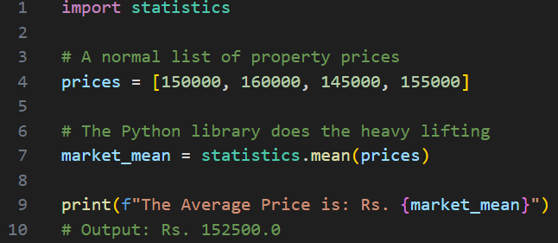
Core Concept (Definition & Rules)
The Mean (Average)

Slide 12
Core Concept (Definition & Rules)
The Median (The Middle)
Definition:
The exact middle value of a dataset when it is ordered from least to greatest. If there is an even number of values, it is the average of the two middle numbers.
Example : Let's look at neighborhood house prices. Five houses cost Rs. 100,000. One massive mansion on the road side costs Rs. 50,000,000. If we use the Mean, the average looks like Rs. 8 million! That's a lie. The Median ignores the crazy mansion, points to the physical middle house on the street, and says: "Most houses here are Rs. 100,000.“

Slide 13
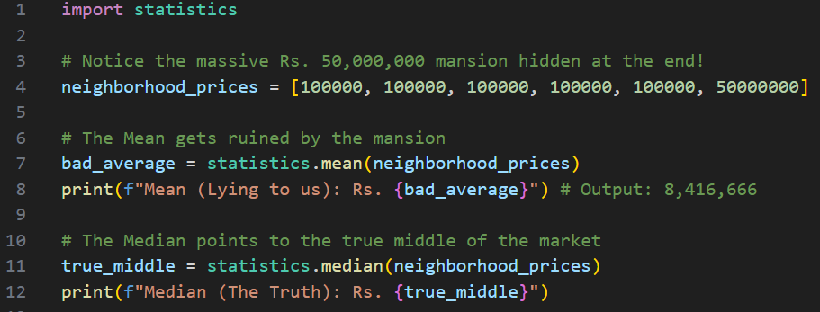
Core Concept (Definition & Rules)
The Median (The Middle)

Slide 14
Core Concept (Definition & Rules)
The Mode (The Most Popular)
Definition:
The value that appears most frequently in a dataset. A dataset can have one mode, multiple modes, or no mode at all.
Example : A shoe store owner is looking at inventory. He doesn't care about the "average" shoe size. He wants to know exactly which size sells the most every single day so he can restock it. If size 9 sells 100 times a day, size 9 is the Mode.

Slide 15
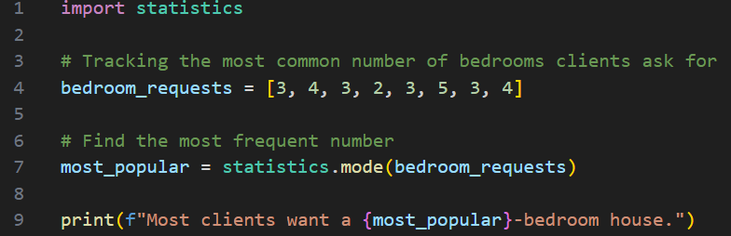
Core Concept (Definition & Rules)
The Mode (The Most Popular)

Slide 16
Thank You for Your Focus Today!
What was the most confusing part of today's lab?
Waleed Khan (Robotics Engineer | Senior Python Developer)
Email: 0xcloudcoder@gmail.com Contact: +923126008702
}
*

